Slide 1

Building Open Source Tools for Safety Monitoring: Advancing Research Through Community Collaboration
Becca Krouse, Rho Inc.
rebecca_krouse@rhoworld.com
Interactive Safety Graphics Taskforce
R in Pharma 2019

Slide 2

safetyGraphics R Package: A framework for evaluation of clinical trial safety
CRAN | GitHub | Demo

Slide 3
Outline
Background and motivation
safetyGraphics Demo
About the Interactive Safety Graphics Taskforce
safetyGraphics technical details
Community use and response
Wrap-up

Slide 4
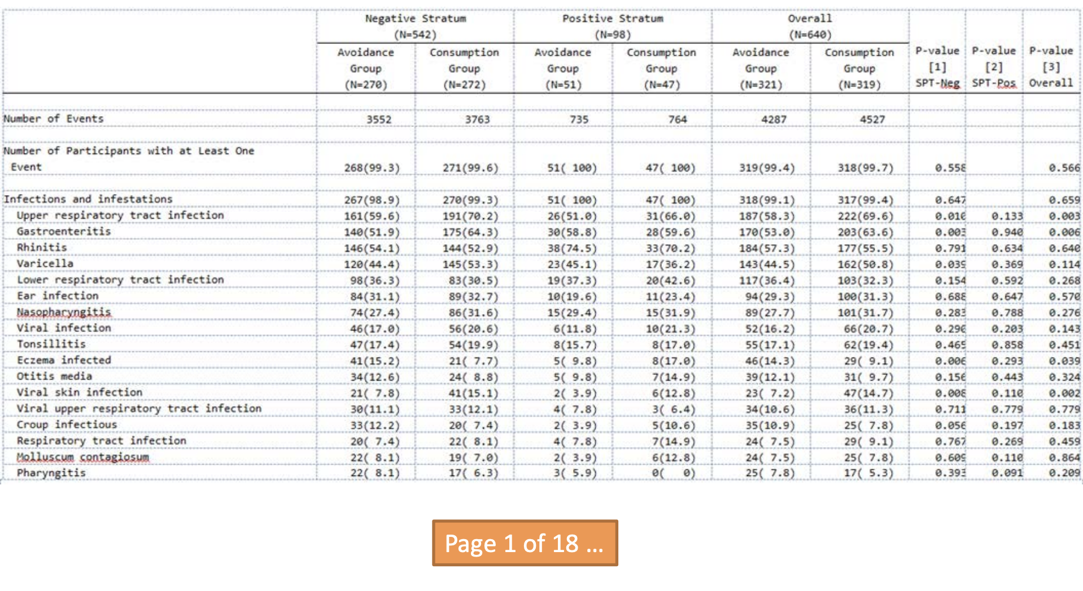
Adverse Events Table: Traditional display

Slide 5
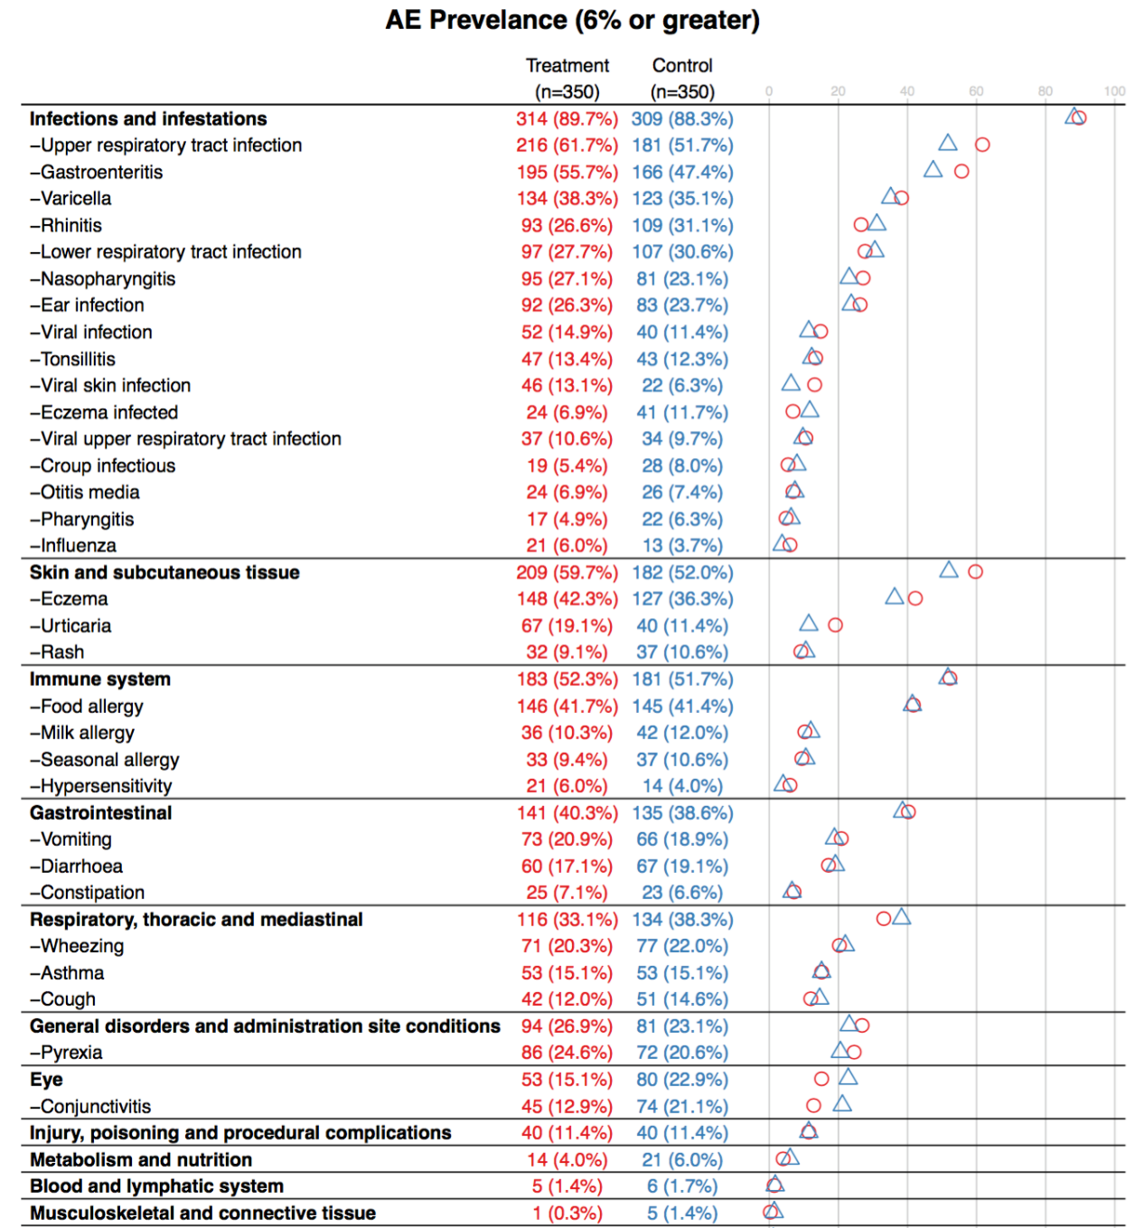
Adverse Events Table: Graphical display
Inspired by Frank Harrell’s ae.dotplot()

Slide 6
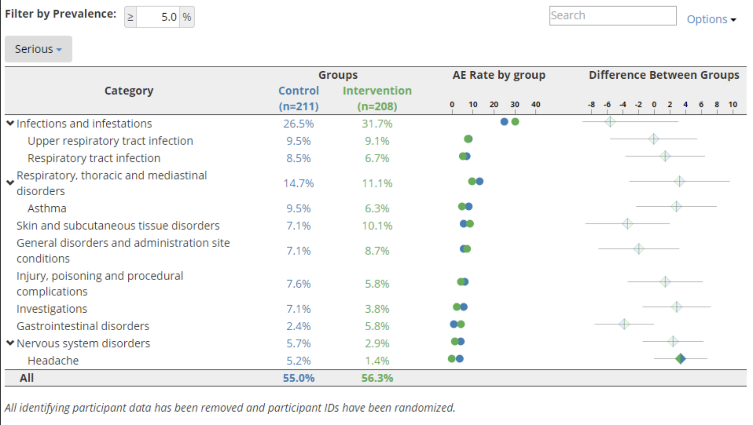
Adverse Events Table: Interactive display
Interactive Demo

Slide 7
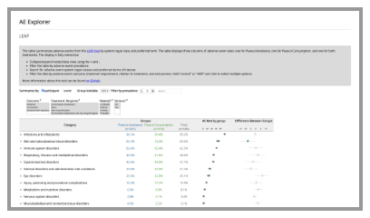
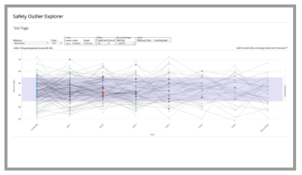
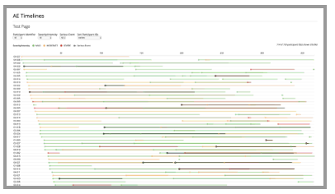
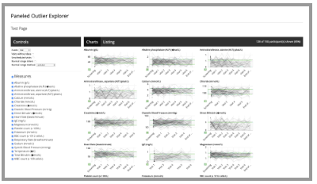
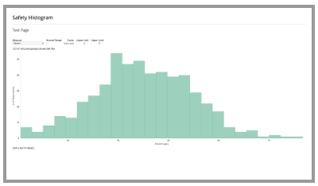
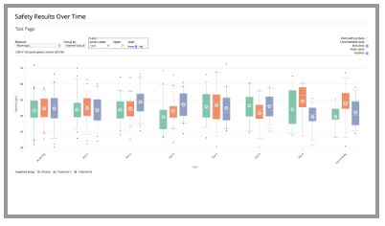
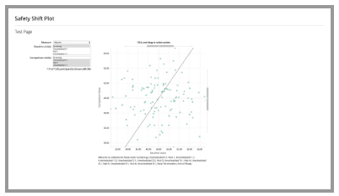
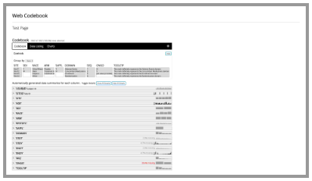
The Safety Explorer Suite
Therapeutic Innovation & Regulatory Science Manuscript

Slide 8
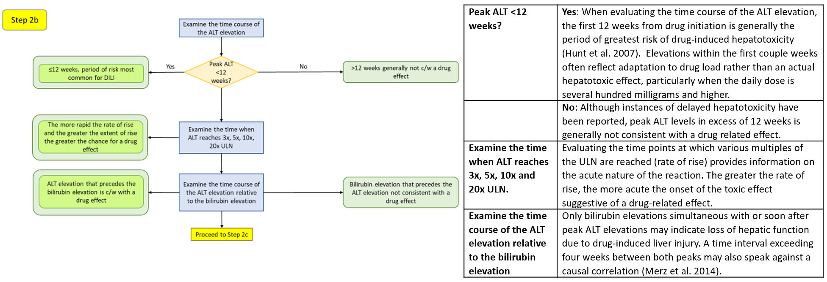
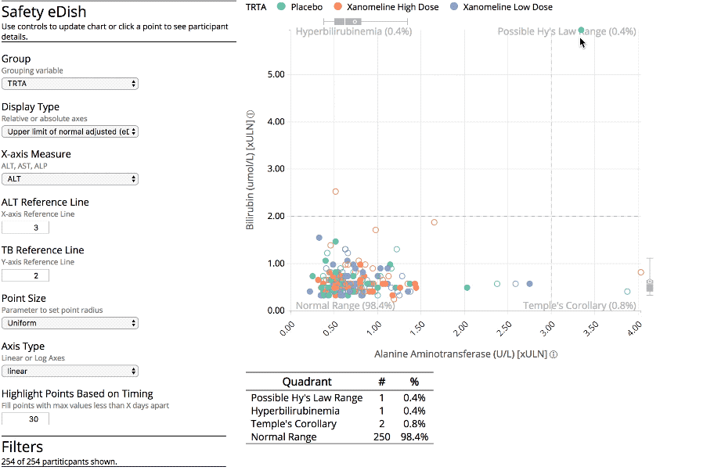
Interactive Safety Graphics Taskforce (ISG): Next level of innovation
+
Interactive Graphic
Clinical workflow

Slide 9
safetyGraphics R Package: A framework for evaluation of clinical trial safety
CRAN | GitHub | Demo

Slide 10
DIA – ASA Biopharm Safety Working Group
Safety Working Group Homepage
Mission: Empower the biostatistics community and interdisciplinary safety management partnerships to better enable qualitative and quantitative safety evaluation throughout drug development life cycle
Work Stream 1: Interdisciplinary Safety Evaluation
Work Stream 2: Statistical Methodology for Safety Monitoring
Work Stream 3: Integration and Bridging Real World Evidence and Randomized Clinical Trials for Safety Decision Making
Interactive Safety Graphics
Taskforce

Slide 11
Interactive Safety Graphics Task Force (ISG): Guiding principles
Highly Collaborative
Open Source
Interactive
Rooted in medical practice
Easy to use & customize
Compliant with Data Standards
Agile & Engaging
https://safetygraphics.github.io/

Slide 12
Interactive Safety Graphics Task Force (ISG): Infrastructure for use in Pharma
Accuracy
Unit tests + CI
Peer code reviews and regression testing
Community pilot testing
Follow R validation hub effort
Reproducibility
Exported report contains code to recreate the chart in R
Full app pipeline can be recreated using the R functions if desired
Extensibility
Generalized platform vs. specialized app
Supporting different chart types
https://safetygraphics.github.io/

Slide 13
safetyGraphics: Behind the scenes
Metadata files
Shiny App
Load Data
Configure Settings
Explore Charts
Export Report
Supporting helper functions

Slide 14

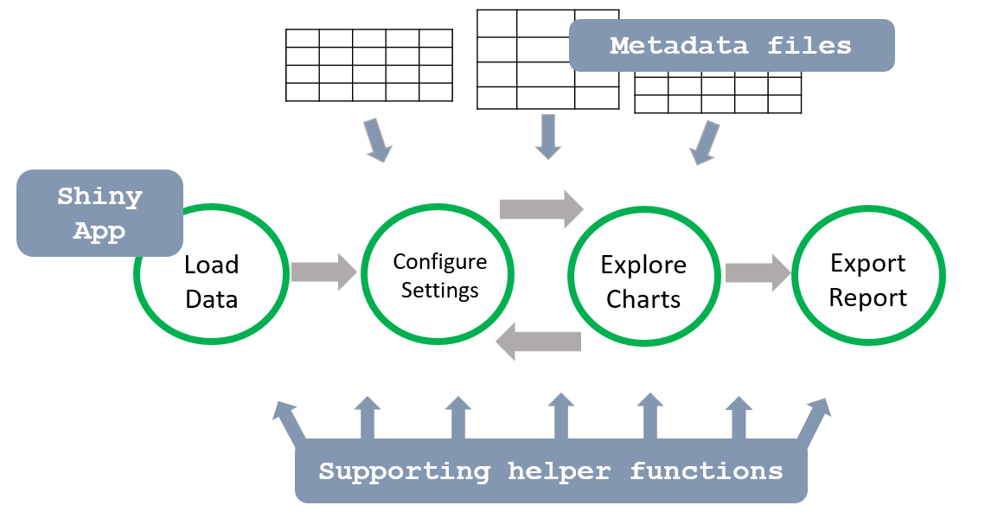
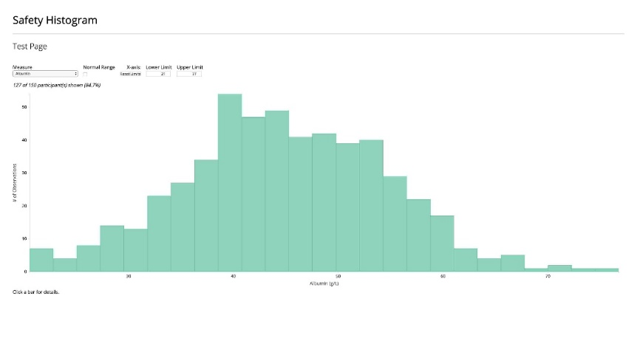
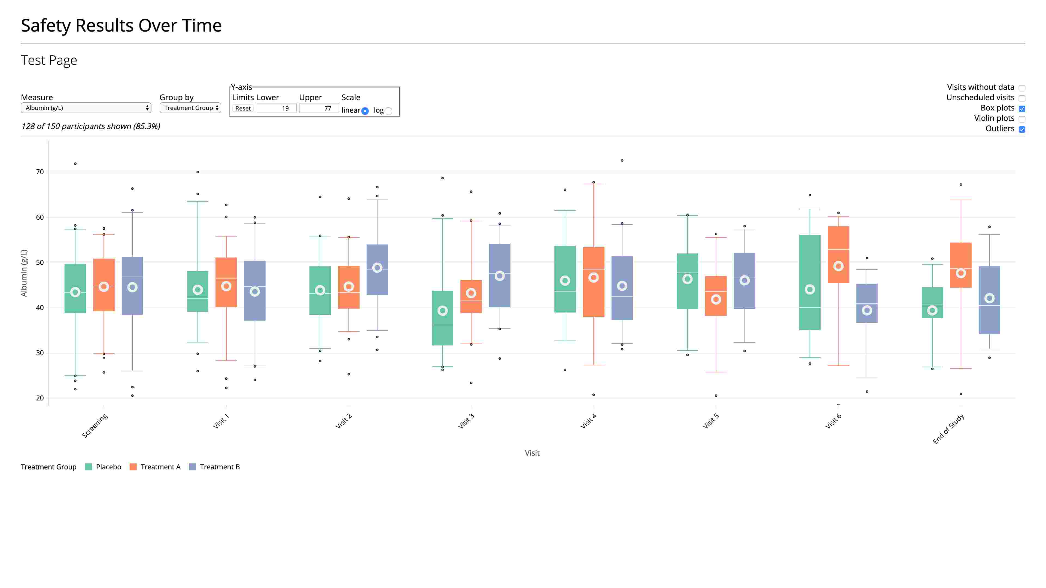
safetyGraphics: Expanding the platform
Charts
Workflows
htmlwidgets
ggplot2
Shiny modules
plotly

Slide 15
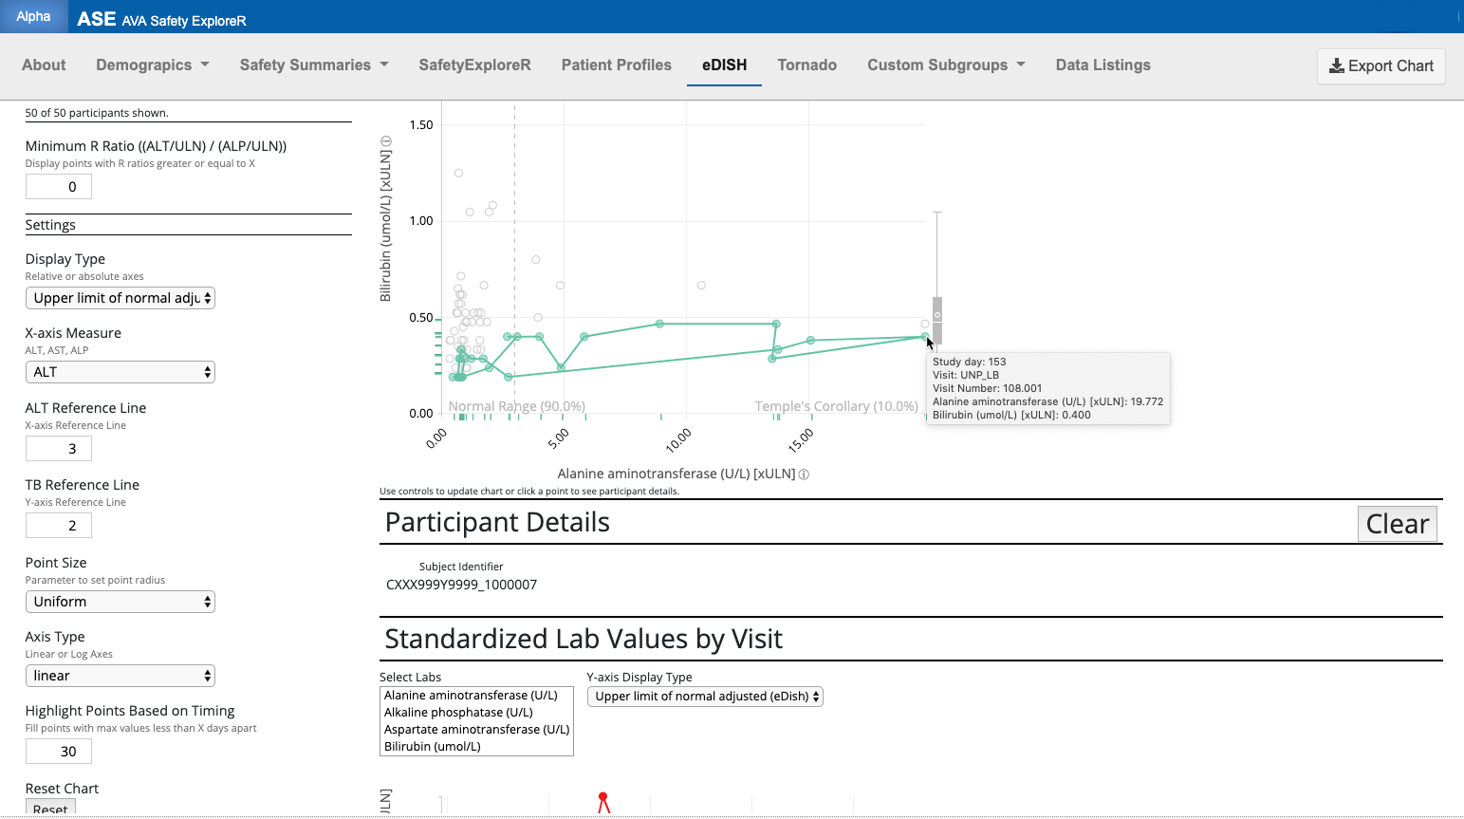
safetyGraphics in Pharma: Case Study
With thanks to Xiao Ni, Novartis

Slide 16
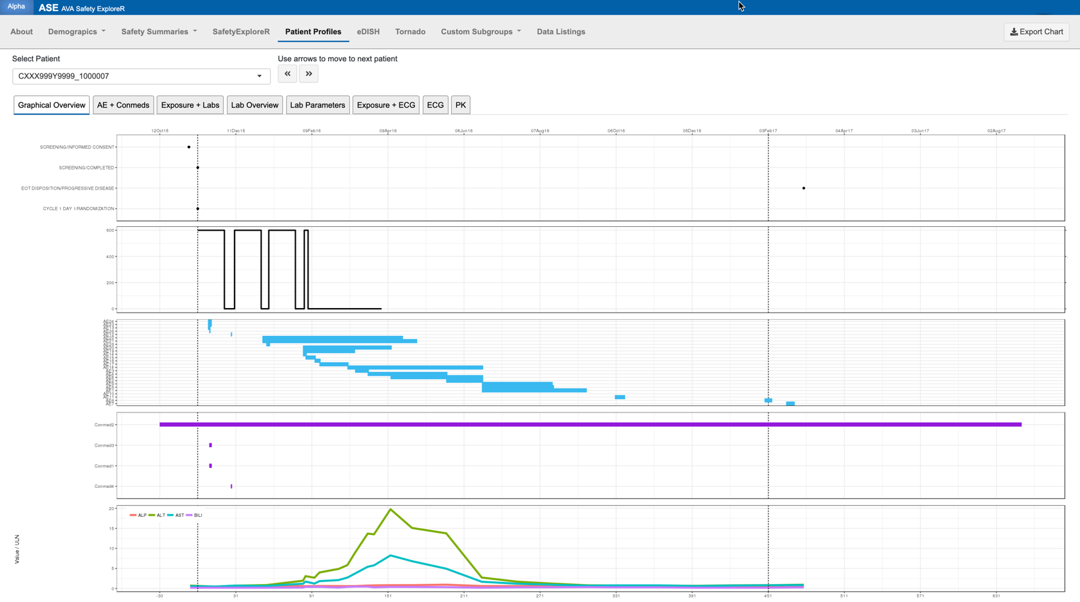
safetyGraphics in Pharma: Case Study
Patient dropdown selector
Disposition
Treatment Exposure
AE
Concomitant medications
Liver function labs
With thanks to Xiao Ni, Novartis

Slide 17
safetyGraphics in Pharma: Case Study
Disposition
Treatment Exposure
AE
Selecting patient from graph automatically links to same patient in the Patient Profiles tab
Concomitant medications
Liver function labs
With thanks to Xiao Ni, Novartis

Slide 18
safetyGraphics in Pharma: Community Response
Pilot tested in a broad pharma setting
Tested by 9 organizations: FDA, Merck, Novartis, BI, Bayer, Abbvie, Lilly, J&J, Rho
All users reported that the tool met or exceeded expectations
None found it difficult to upload data using the R package
~50 specific comments / requests
Several teams working on pilot deployments
Collaboration with FDA
Active participation in working group
Presented at FDA Innovation Forum
Multiple FDA speakers mentioned ISG work at 2018 R/Pharma
Embraced by leaders in the R community
Presented at 2019 Rstudio conference
Thanks to Joe Cheng and Phil Bowsher for their support

Slide 19
Summary
Interactivity using R is gaining traction in pharma
R toolset extends reach to non-technical users
R facilitates reproducibility
Open source encourages collaboration and innovation
Evolution, enhancements naturally follow industry adoption of tool
Community collaborations address a common need
Clinical + technical expertise = powerful combination
Widespread support results in highly vetted toolset

Slide 20
Next steps – feature development:
Chart & Workflow Creation
Improve existing charts
New Charts and Workflows:
Nephrotoxicity
QTc Prolongation
Volcano Plot Explorer
Recurrent AEs
Allergy/Immunology
Platform Improvements
Support Multiple Data Domains
Easy communication between charts
Embedded access to clinical workflows within the shiny app
Optimized graphics for studies with very large data sets
Facilitated “real-time” statistical analysis
Formalized Maintenance Model

